Slide 1


Slide 2
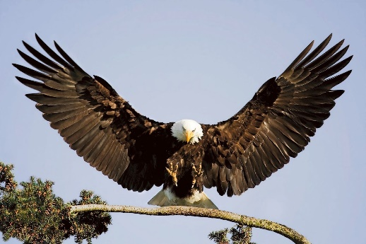
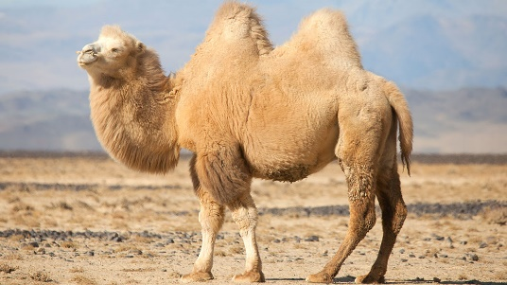
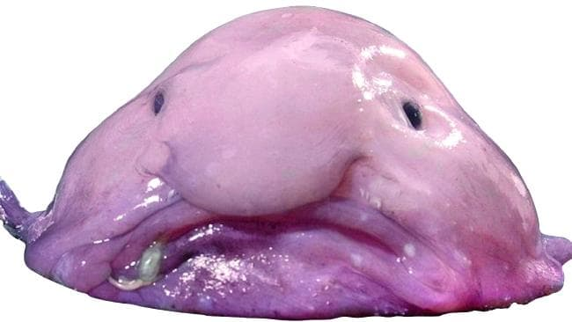
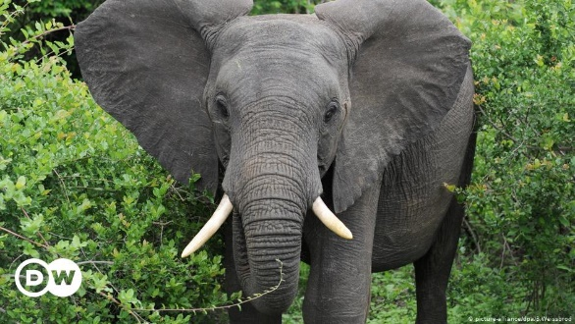
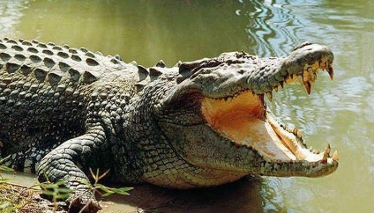
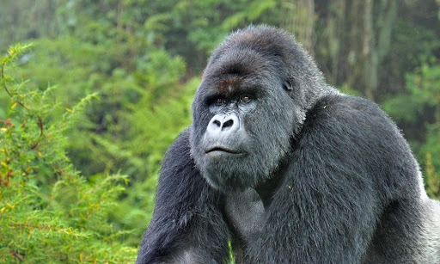
Which’s animal?

Slide 3
Which animals are in danger?

Slide 4
UNIT 3: WILD LIFE
Lesson 7
WRITING
• Animals in danger

Slide 5
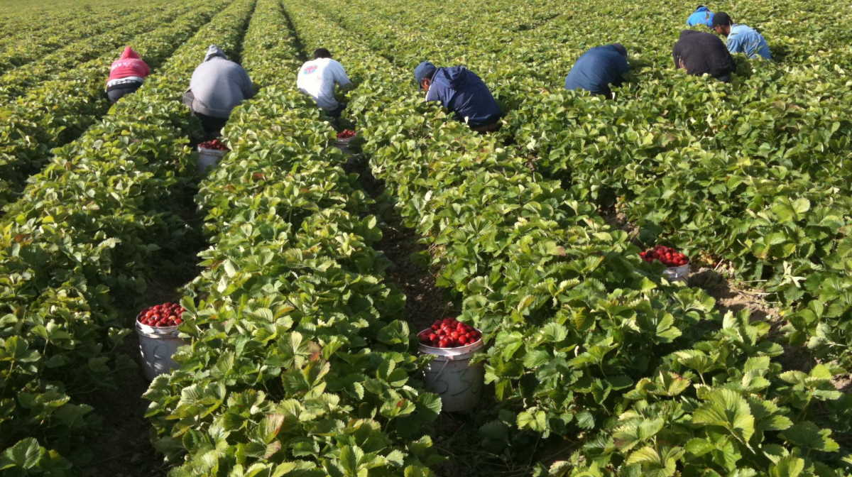
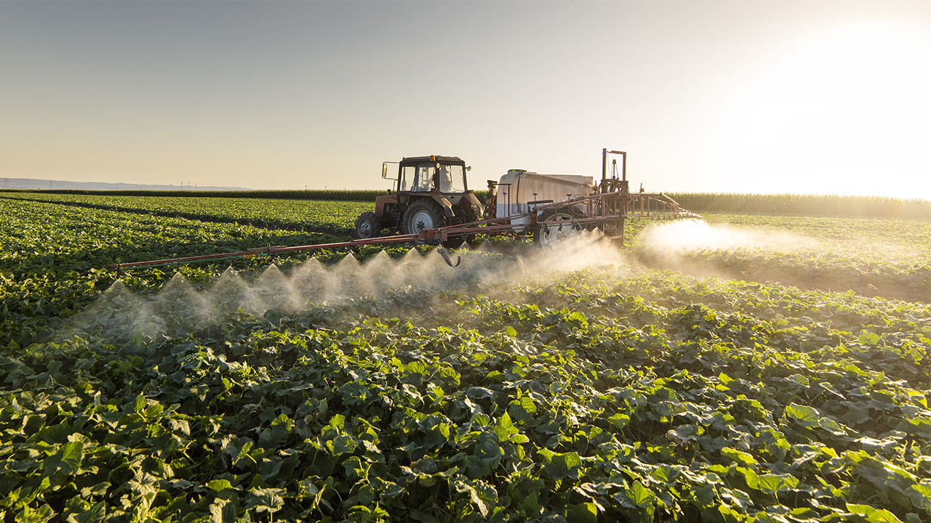
farming(n)
/ˈfɑːr.mɪŋ/

Slide 6
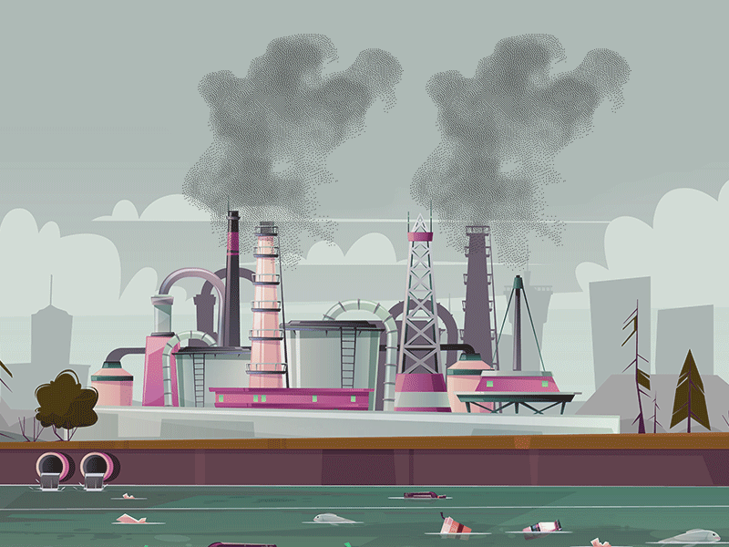
pollution(n) /pəˈluː.ʃən/

Slide 7
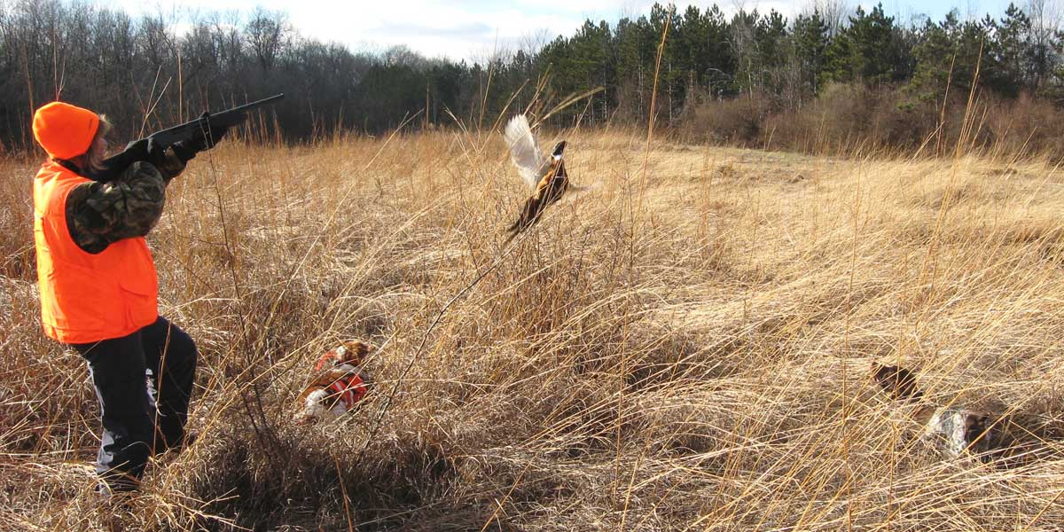
hunting(n) /ˈhʌn.t̬ɪŋ/

Slide 8

New words
explain(n) /ɪkˈspleɪn/
Ex: Teacher explains how to do this exercise.
adopt(n) /əˈdɑːpt/

Slide 9
- such as = like:
- For example:
We can use such as, like, For example to introduce an example or examples of something we mention.

Slide 10
New words
- farming(n) /ˈfɑːr.mɪŋ/
- pollution(n) /pəˈluː.ʃən/
- hunting(n) /ˈhʌn.t̬ɪŋ/
explain(n) /ˈɡet̬.ʌp/
adopt(n) /ˈɡet̬.ʌp/
- such as = like:
- For example:

Slide 11
ACTIVITY 1.
a) Farming is a problem for the Philippine eagle.
b)
It’s one of the biggest birds in the world, and it’s in danger and very rare.
It eats snakes and small animals such as bats, rats and small monkeys.

Slide 12
ACTIVITY 2.
1. eight kilos / one metre long
2. small animals ... snakes, bats and rats
3. in danger
4. on the website (of the Philippine Eagle Foundation)

Slide 13
ACTIVITY 3.
We can use For example at the start of a sentence. For example has a comma after it.

Slide 14
1 Eagle eats small animals such as snakes,
bats, and rats.
Noun
2 The biggest problem is human activity like farming.
Noun

Slide 15
3 For example, it is possible to ‘adopt’
an eagle.
S
V
O

Slide 16
such as + Noun = like + Noun
For example, S + V + O

Slide 17


Slide 18

Writing time

Slide 19
homework
- Do exercise in workbook page 29
- Prepare for the next lesson:
CLIL • Natural science: animals

